Slide 1
Forming Intentional [active] disciples
A parish presentation by Fr. Gabor, Aberdeen, UK
Based on Sherry Weddel’s book: ‘Forming Intentional Disciples’

Slide 2
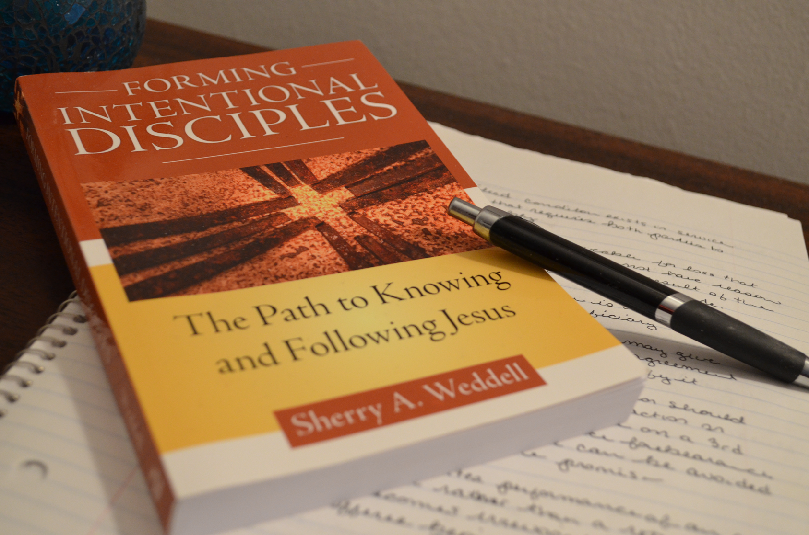
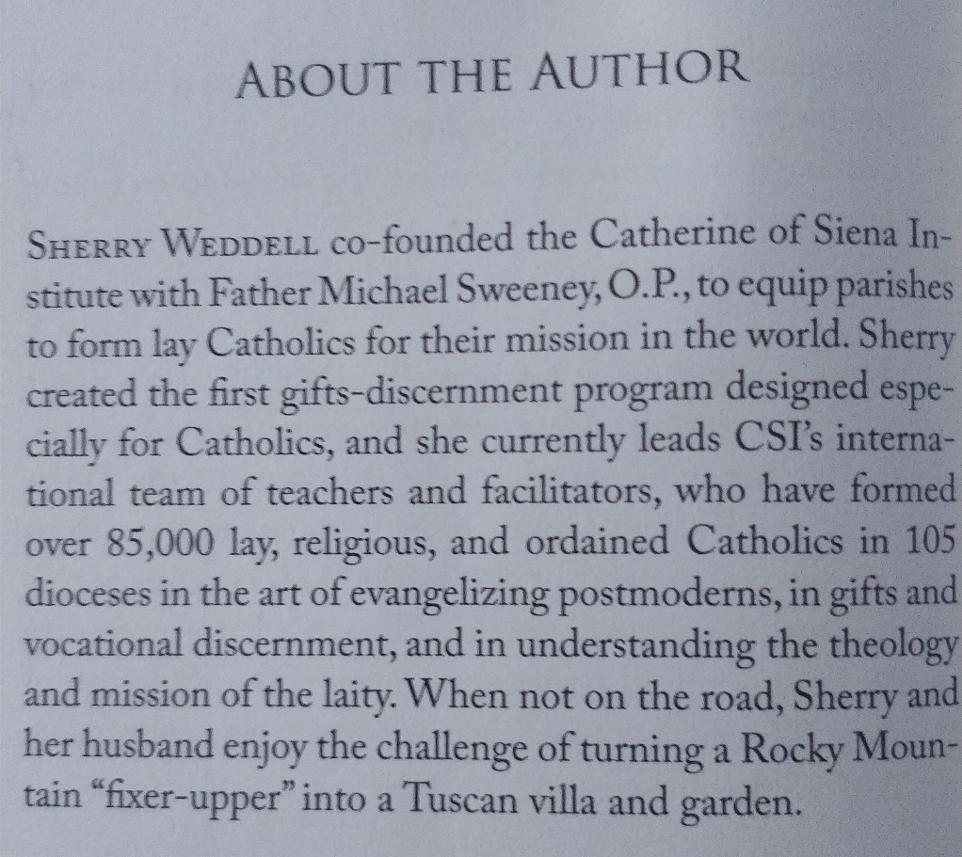
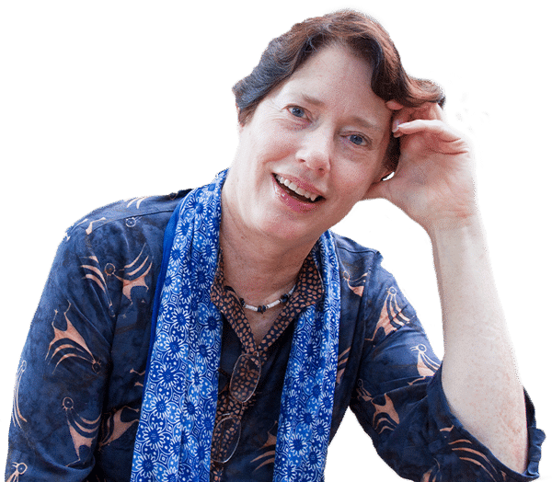
Discipleship
A parish presentation by Fr. Gabor, Aberdeen, UK
Based on Sherry Weddel’s book: ‘Forming Intentional Disciples’

Slide 3
Basis of the book - The experience of tens of thousands of Catholics who were actively involved in Churches (living Catholicism) - 1600 parish and Diocesan leaders who shared their experience of struggle and hard-won wisdom - the experiences of the Catherine of Siena Institute (US) staff, teachers, collaborators in working with people who are actively involved in discipleship training and apostolate

Slide 4
Title Forming: helping others Intentional: active, conscious, willing, enthused (see detailed explanation further down) Disciples: those who learn and follow the ways of Jesus

Slide 5
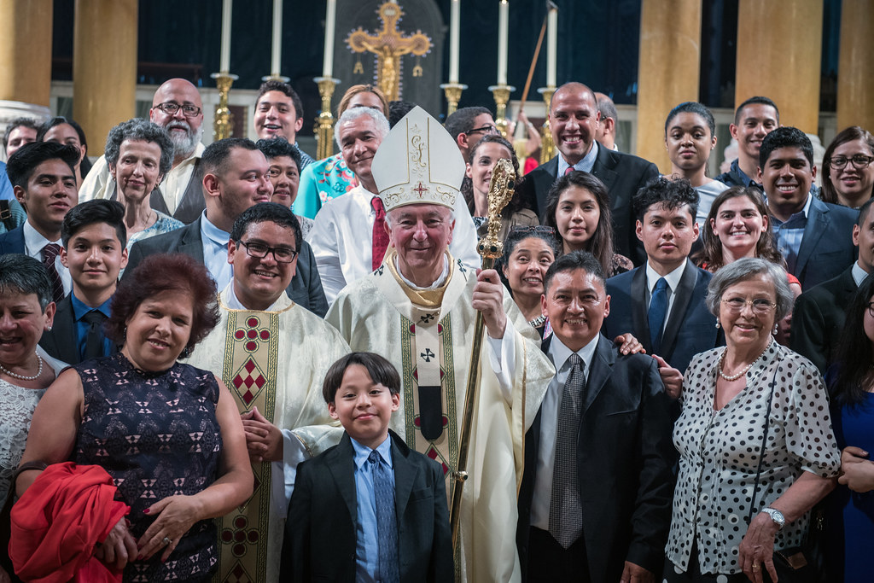
Who is this presentation for?
For those who
want to review their discipleship
want to become disciples
Want to help others become disciples

Slide 6
assessing the state of discipleship of today
Image: “Paul Preaching to the Athenians,” Leonard Porter Studio, 2009
This Photo by Unknown Author is licensed under CC BY-ND
Notes:
So without vilifying, condemning, blaming, or name-calling, we can look around and say whatever were doing isn’t suited for the current setting here in the United States. This is not about playing armchair quarterback on the past, or looking down from an elite position at any other person. It’s just this--our ways of making disciples are not actually making disciples. And since we’re supposed to make disciples, that’s a problem. The biggest problem. The root problem. The issue that underlies anything else we can look around and want to see more of—vocations, confession, social justice, engagement with culture, sacrificial giving, participation in the liturgy, faith filled marriages—anything.

Slide 7
Climate Change
In our age religious identity is not stable, but remarkably fluid, globally, and in all denominations
The spiritual winds blow both ways in our postmodern world:
into and out of the Church.
Our spiritual climate provides us with real opportunities
…and very definite threats
if we do not adjust our evangelizing, catechetical, and pastoral practice to the unique challenges
of the times in which we live.
-- Weddell, Forming Intentional Disciples, 18
This Photo by Unknown Author is licensed under CC BY-NC-ND
Notes:
Not all gloom and doom. Not us vs. them or a “Christ against culture” scenario.

Slide 8
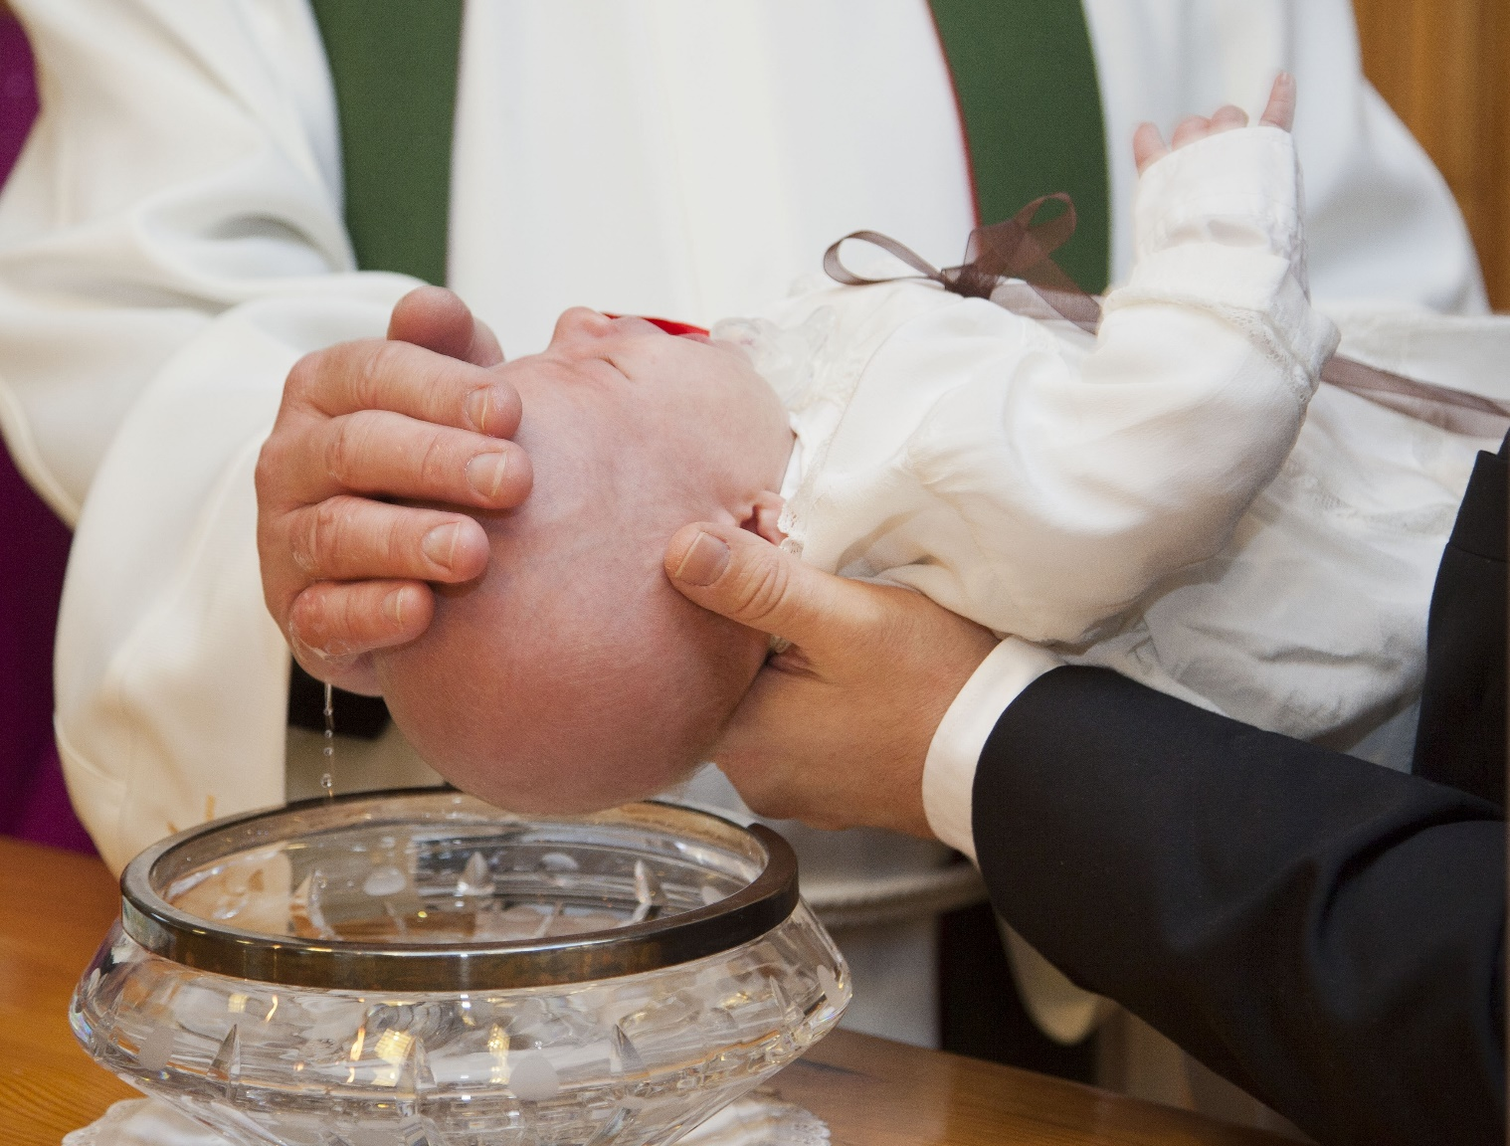
The result of an extensive research on the present situation and challenges of the Catholic Church (mainly in the US) – can we learn from them?
the majority of Catholics in the United States
are sacramentalised (ie. received the sacraments) but not evangelized
They do not know that an explicit, personal attachment to Christ—personal discipleship—is normative Catholicism as taught by the apostles and reiterated time and time again by the popes, councils, and saints of the Church.
-- Weddell, Forming Intentional Disciples, 46
Notes:
End up here. For example

Slide 9
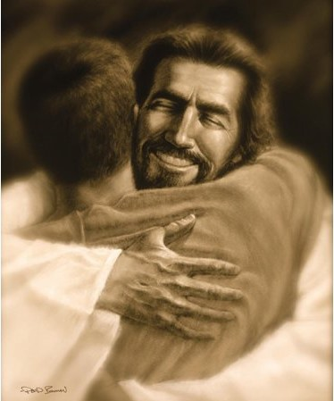
48%
only
of Catholics
were absolutely certain that the God they believed in was a God with whom they could have a personal relationship
Forming Intentional Disciples, Chapter 1
Notes:
and each one of us here can probably think of other examples—it’s clear from our Tradition that the way of a disciple includes a response in worship, in Eucharist…and yet only 18% of Catholics attend Mass weekly;

Slide 10
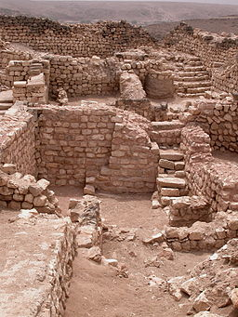
Living in the land of ‘NONE’ pp.20-21
NONE= Unaffiliated (not belonging to any church)
This doesn’t mean they are agnostic (someone who claims you cannot get to know God)
In fact many are open to religion or to a religious identity
30% were even members of a congregation in Chicago
Another 30% just hasn’t found the congregation they were looking for
This means an opportunity to help them become disciples of Christ
This Photo by Unknown Author is licensed under CC BY-SA

Slide 11
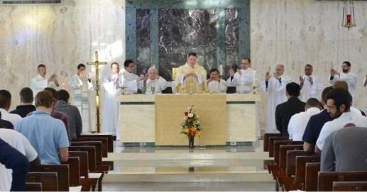
Who is at Mass?
We assume Catholics are at Mass, but this is not necessarily true today.
‘Nones’ (those not belonging to any Church organisation) routinely float in and out of our churches, and they are often remarkably open to the church.
Read an amusing example on p. 22

Slide 12
Ebb and flow pp.24-29
Why do people leave the Catholic Church?
‘My Spiritual needs are not met (71%)
‘I found a religion I liked more (70%)
Sexual abuse scandal (21%)
Separation or divorce (3%)

Slide 13
Ebb and flow p.29
Becoming protestant, why?
‘Enjoyed new faith services and worship (81%)
‘Felt called by God’ (62%)

Slide 14
Becoming a ‘None’, pp.31-33
Why I left Catholicism and became unaffiliated
‘Just gradually drifted away (71%)
‘Stopped believing in the religion’s teaching (65%)
Sexual abuse scandal (27%)
Separation or divorce (3%)
Some lapsed don’t believe in God/most religious teaching , eg. on abortion, homosexuality, birth control, divorce and marriage (42%)
Have not found the right religion (33%)

Slide 15
Young adults and religious change, pp. 33-34
Catholics who leave, leave early (nearly 50% of them leave by the age of 18)
This Photo by Unknown Author is licensed under CC BY-ND

Slide 16
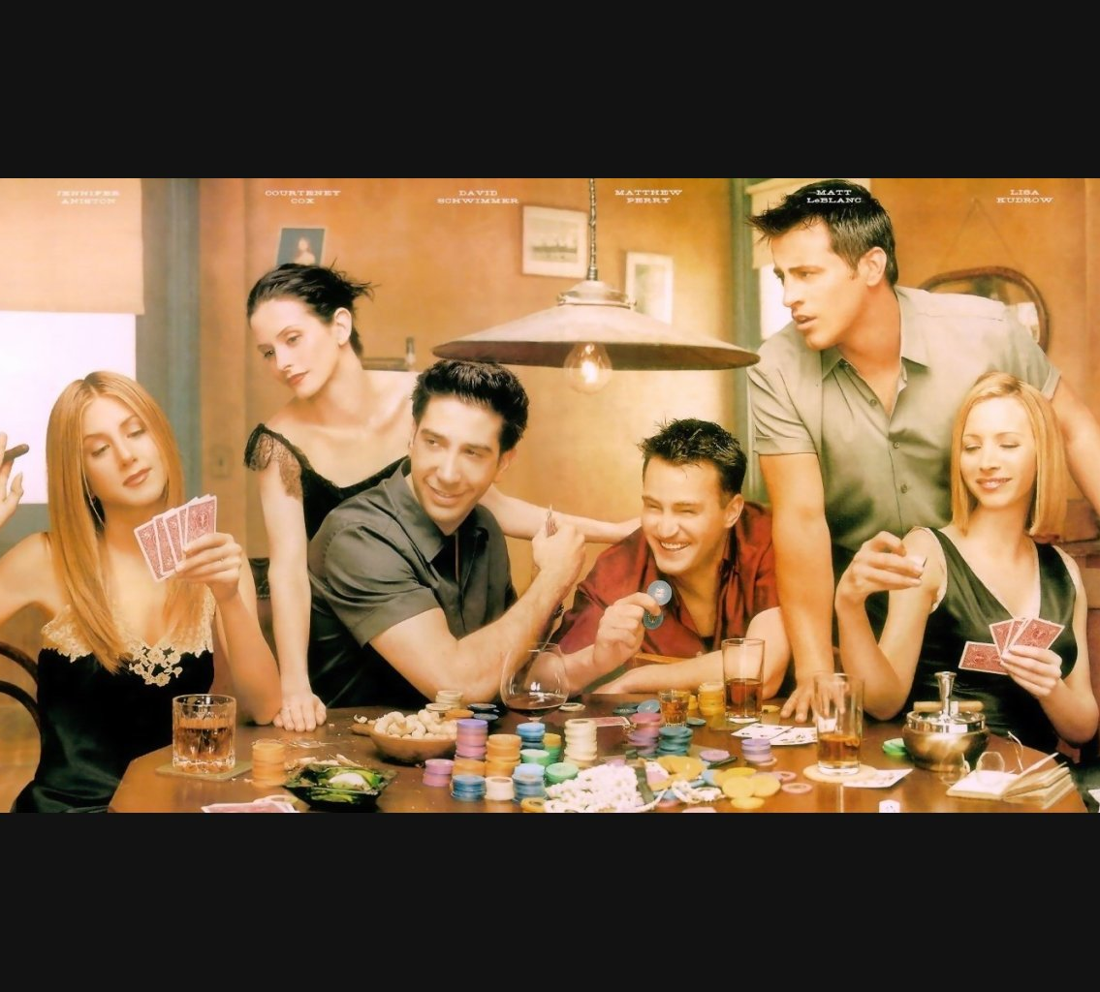
What worked before doesn’t work anymore, pp.34-35
Childhood Catholic education alone does not have enduring effect throughout life anymore (it worked in the 17th c.)
Attending youth groups, Catholic high schools make little or no difference in the US
BUT building upon childhood and teenage experience is most likely to translate into lifelong faith and consistent spiritual practice.
Ironically, it is going to a Protestant church as an adult that gives you more chance to return to regular Mass attendance later on.
This Photo by Unknown Author is licensed under CC BY

Slide 17
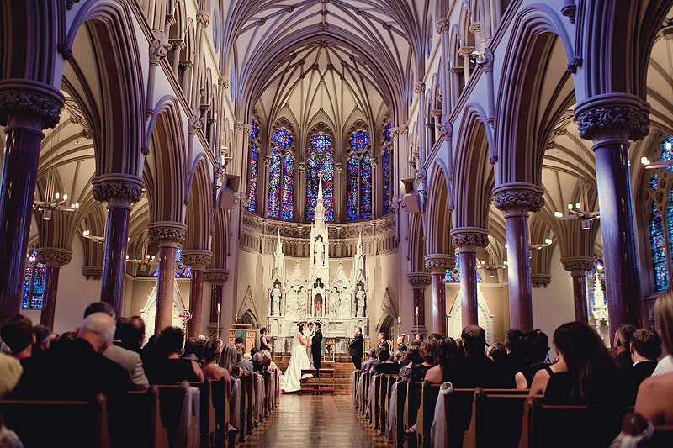
Won’t the sacraments bring the lapsed back? pp. 36-39
Will marriage bring them back? The answer is worrying while many Catholic who want to get married come back to the church for marriage preparation, their number is dropping, because less and less Catholics want to get married in the Catholic Church (26% drop between 1972-2010).
The number of young Catholics who are practicing their faith is also dropped. In that case why would young Catholics want to raise their children in the faith?
This Photo by Unknown Author is licensed under CC BY-SA-NC

Slide 18
‘In the 21st c. cultural Catholicism is dead as a retention strategy, because God has no grandchildren. In the 21st c. we have to foster intentional Catholicism rather than cultural Catholicism.’ (Sherry Weddell), p. 39

Slide 19
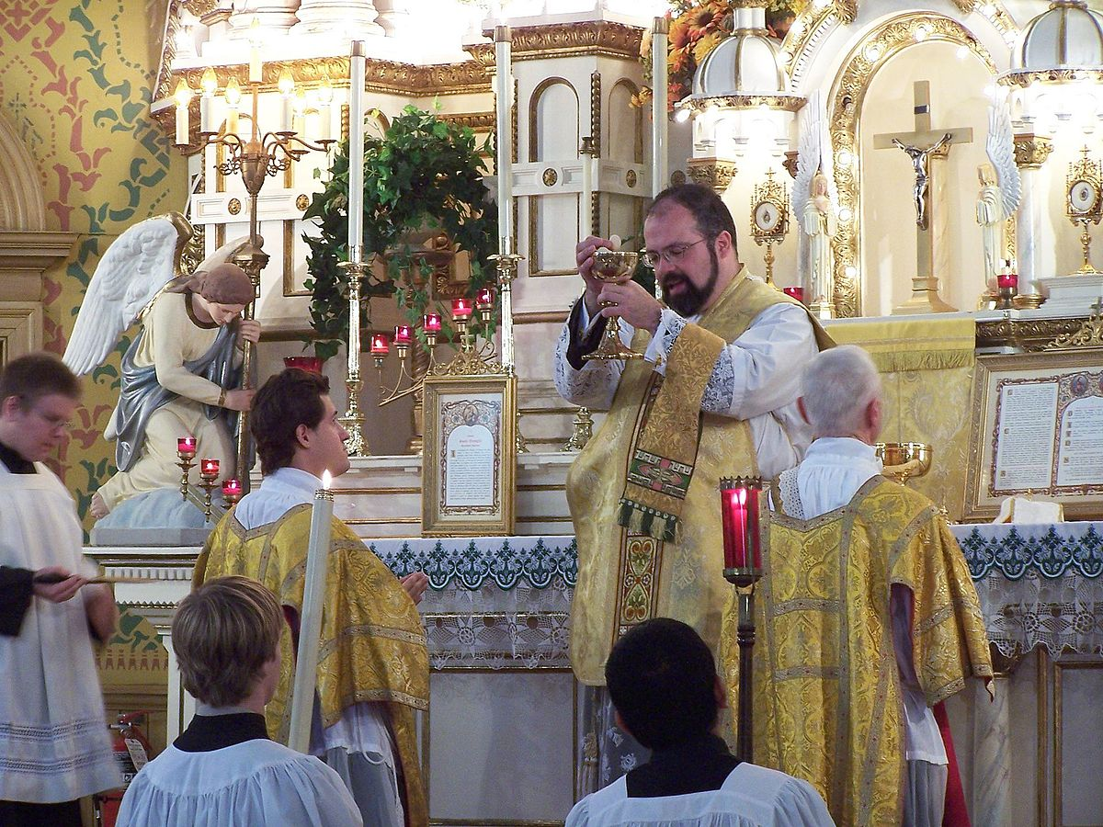
The liturgy and staying in the church
What keeps people in the church?
- If the liturgy is ‘lively and exciting’ (for 61% of Hispanic Catholics)
- 71% of them said he liturgy was lively and exciting, while 36% of them converted to Protestantism, because they didn’t find Catholic liturgy lively and exciting.
- ‘Is this factor just a matter of different tastes?’
p.41
This Photo by Unknown Author is licensed under CC BY-SA

Slide 20
Multitudes in the valley of decision
Change from childhood faith to adult faith goes through a series of steps, and not through a single giant leap.
That is true also to when people leave the church; they go through a serious of painful experiences and decisions.
Our job is to reach out to them and help them find the pearl of great price!
p. 42
This Photo by Unknown Author is licensed under CC BY-NC-ND

Slide 21
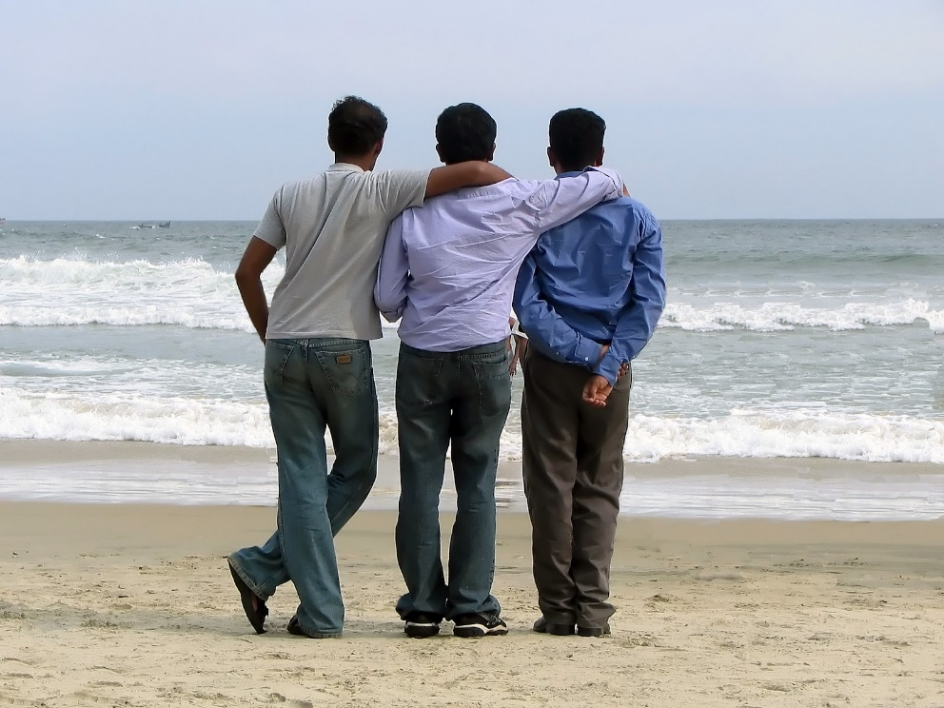
It’s all about relationship, pp. 43-47
1/3 of self-identified Catholics believe in an impersonal God.
So only 60% of Catholic believe in a personal God
That raises the question about how many Catholics feel that their faith makes sense, if they don’t have a personal relationship with God.
This Photo by Unknown Author is licensed under CC BY

Slide 22
For younger Catholics personal relationship with God matters, but not so much for older Catholics.
All in all we live in a time of immense challenge and opportunities.
This Photo by Unknown Author is licensed under CC BY-NC-ND

Slide 23
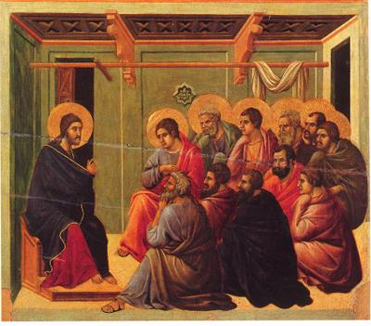
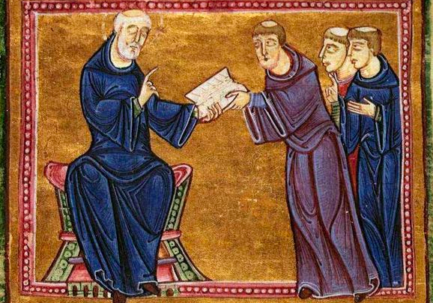
The Catechism of the Catholic Church says that disciples
Profess, spread, and live the faith of the Church (§1816)
Establish habits befitting a disciple of Christ (§1494)
Are initiated and nourished by the Eucharist (§1275)
Respond to Jesus’ invitation to enter His kingdom (§546)
Pray (§2601, 2612)
Abide in the Word (§2466)
Witness to Christ and work using the gifts received from God, in ecclesial and temporal affairs (§1319, 2427)
Imitate Jesus (§2347, §2470)
Notes:
Mvm’t from being followers of Jesus in an immediate, physical/earthly sense, to encountering the resurrected Jesus, to disciples discipling others, like St. Benedict’s vision for his monastery

Slide 24
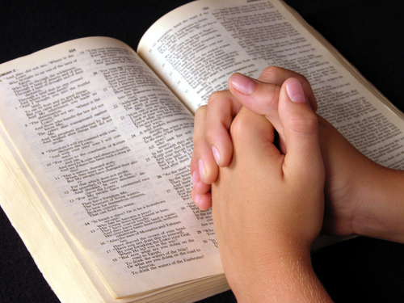
discipleship as transmitted by the Church is:
an active response to Mt 19:21, Mk 10:21, Lk 18:22
for everyone
personal (yet in Church community)
‘Jesus said to him, “If you wish to be perfect, go, sell your possessions, and give the money to the poor, and you will have treasure in heaven; then come, follow me.’ (Mt 19:21)
Notes:
Not possible to do unconsciously.
Not ust for monks, priests, canonized saints
Can’t have the community w/o those individual decisions.

Slide 25
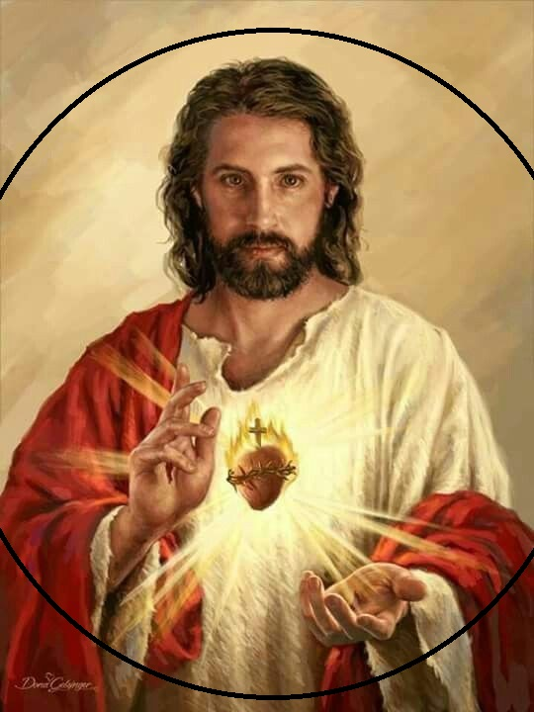
Developing a Personal relationship with Jesus - create the conditions for personal encounter with Jesus Christ (share your personal relationship with Jesus) - relationship with Him is formed by ‘remembering’ the major events of His life (eg. in the Eucharist) Being Christian is not the result of an ethical choice or a lofty idea, but the encounter with an event, a person, which gives life a new horizon and a decisive direction. -- Pope Emeritus Benedict XVI, Deus Caritas Est §1 p. 52

Slide 26
This personal relationship with Jesus is experienced by the work of the Holy Spirit. The goal of evangelisation is to bring people to the Father, through Christ, in the Holy Spirit. (Eph 2:18) P. 53

Slide 27
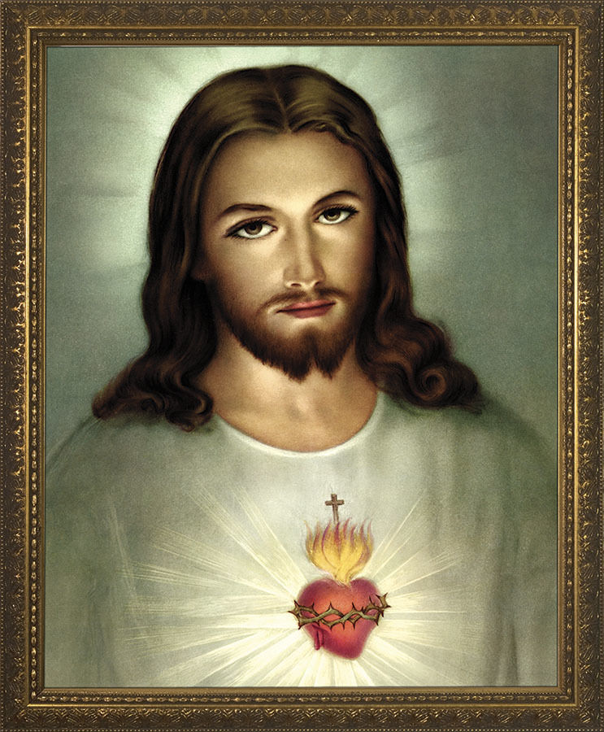
We can’t successfully help others enter into a relationship with Jesus unless we ourselves are already in a personal relationship with Him. P.53

Slide 28
three spiritual journeys
1
2
3
The personal interior journey of a lived relationship with Christ which results in intentional discipleship.
The ecclesial journey into the Church through reception of the sacraments of initiation.
The journey of active practice – receiving the sacraments, attending Mass, and participating in the life and mission of the Christian community.
1
2
3
+ many more variations…
Weddell, Forming Intentional Disciples, 54
Notes:
Foundational concept, lynchpin for understanding her message, most underrated passage in the obok…
Dyad discussions on this. Going to look slightly different for just about every person. And it’s not just yes/no on a spiritual journey, there are stages, phases, different levels of enthusiasim, etc. The point is, there’s an incompleteness without all three in place, not a mature Christian w/o all three. And so FID as a book is really about Journey #1, since she believes this is the journey that we’re most silent about in our current setting, and is critically important in our society of seekers, “nones,” and the like.
Spiral of Silence ad Don’t Ask Don’t Tell are another way of saying that journey #1 is the elephant in the room. Overlooked. Not talked about. Not resourced. Not even consciously considered by many.
Sacramental theology in chapter 4 is in one sense an apologetic towards those who might think that emphasizing #1 has nothing to do with #2
The 5 Thresholods are a practical framework for cultivating #1 in our society

Slide 29
These three journeys are often separate in Catholics (see p.54), eg. for us to be a member of the church merely means to go to Mass, but does not necessarily mean having a personal spiritual relationship with Jesus. However these 3 journeys should be connected to one another. (p.54) Often those doing the 2nd and 3rd journeys don’t look for personal relationship with Jesus (1st journey)/ Personal discipleship is often regarded as an optional extra for the exceptionally pious.

Slide 30
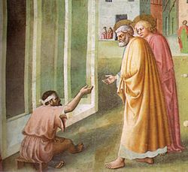
Since our interior journey of discipleship (journey 1) is often neglected witness of discipleship before others doesn’t often happen and is not the norm for many Catholics.

Slide 31
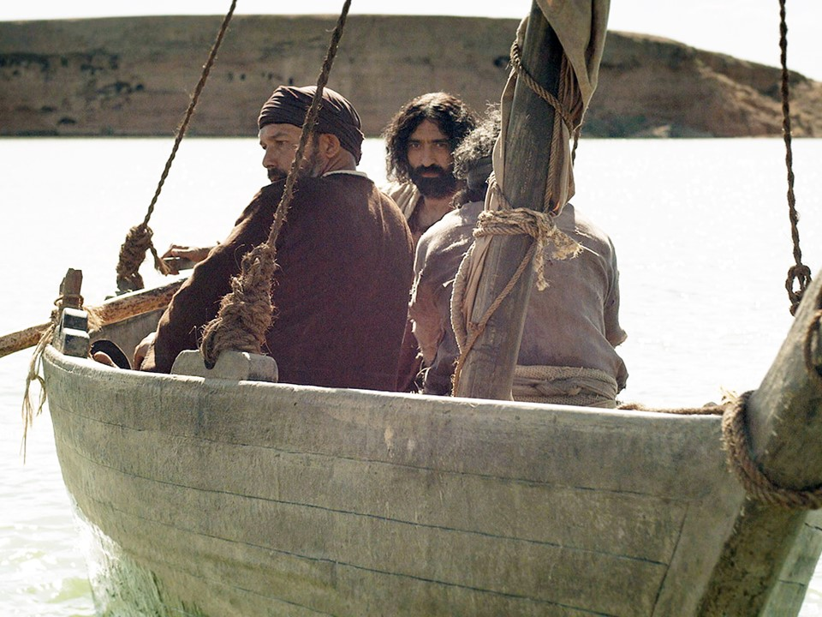
1
key
point
intentional discipleship
All we meant…was “intentional” as in Peter and his brother, on the sea of Galilee, they dropped their nets, and they followed him.
You don’t do that accidentally, you don’t do it in your sleep,
and neither can any of us be disciples in our sleep!
--Sherry Weddell, online interview with Bishop Sheridan (Colorado Springs)
This Photo by Unknown Author is licensed under CC BY-NC-ND

Slide 32
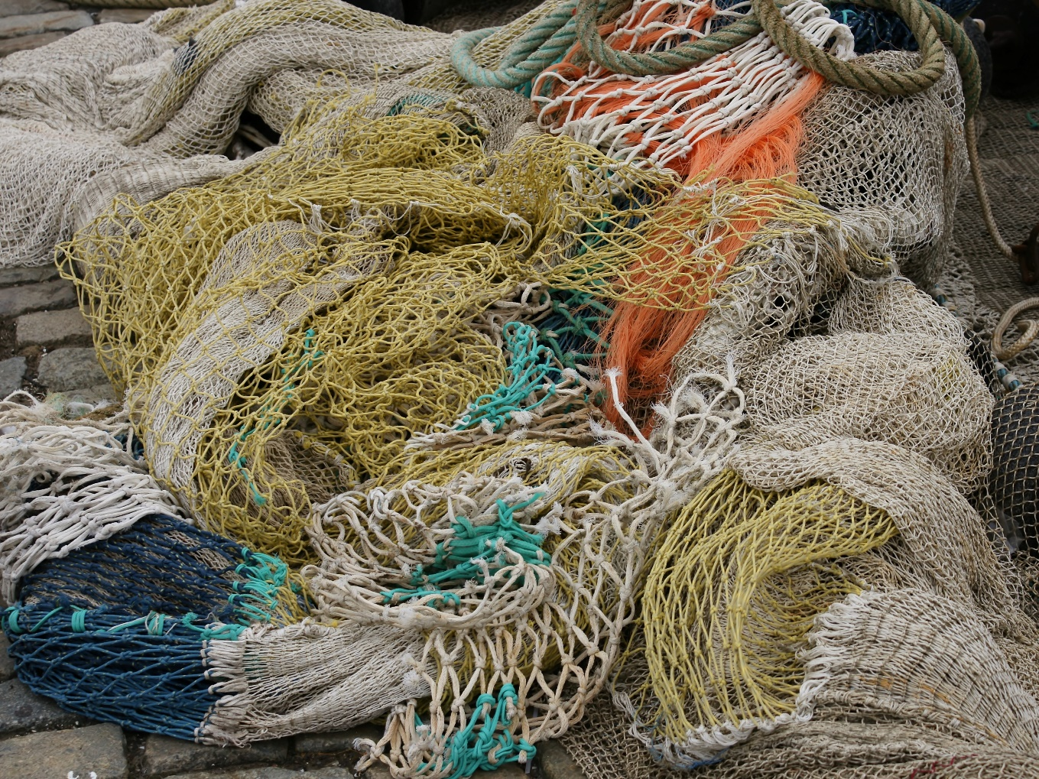
What is [intentional] discipleship? It is a conscious decision to ‘drop the net’ and follow Jesus. (see Lk 5:10-11) ‘No one voluntarily sheds his or her job, and whole way of life accidentally or unconsciously. Simon Peter’s ‘drop the net’ decision is what we mean by ‘intentional’. From the moment he dropped his net he was a disciple.’ (Weddell, p. 65) He consciously began the journey of following Jesus. This should come from a Holy Spirit-given ‘hunger and thirst for righteousness’.
This Photo by Unknown Author is licensed under CC BY-SA

Slide 33
2
key
point
characterizing intentional discipleship

Slide 34
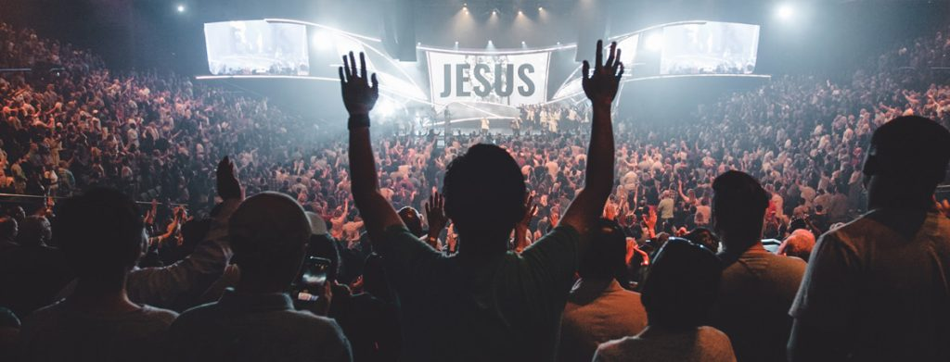
Discipleship should come from a desire to worship and love the Blessed Trinity with all our hearts, and souls and minds and strength and the desire to love one’s neighbour as oneself. (p. 66) Discipleship begins when an adult hears the basic message (kerygma) of Christianity, renews his/her own baptismal promises, consciously chooses Christ as his/her personal Lord and Saviour and commits himself/herself actively in the life if the local church. (p. 66)

Slide 35
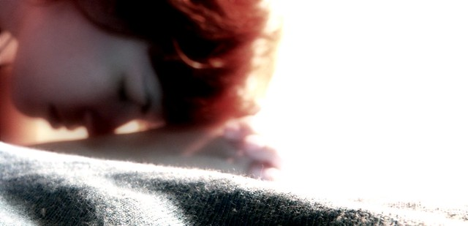
Discipleship is being ‘Surrendered to the Lord Jesus in the power of the Spirit in the heart of the Church.’ (p.75) [something similar to what Patty Gallagher said about the Duquesne University retreat weekend in 1967 where the Charismatic renewal started ] see: https://vimeo.com/173525428 PEOPLE NEED TO SURRENDER THEIR LIVES TO JESUS, TO BE WITH HIM AND LIVE WITH HIM

Slide 36
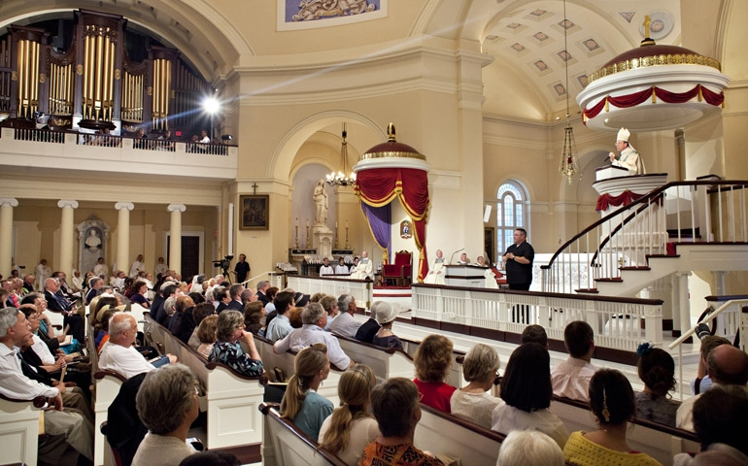
3
key
point
intentional discipleship is ecclesial (‘church-like’)
Notes:
Forming Intentional Disciples talks a lot about personal relationship with God. An individual’s consciousness. And, this is definitely rooted in the language of recent popes. But is it too much “me and Jesus” spirituality?

Slide 37
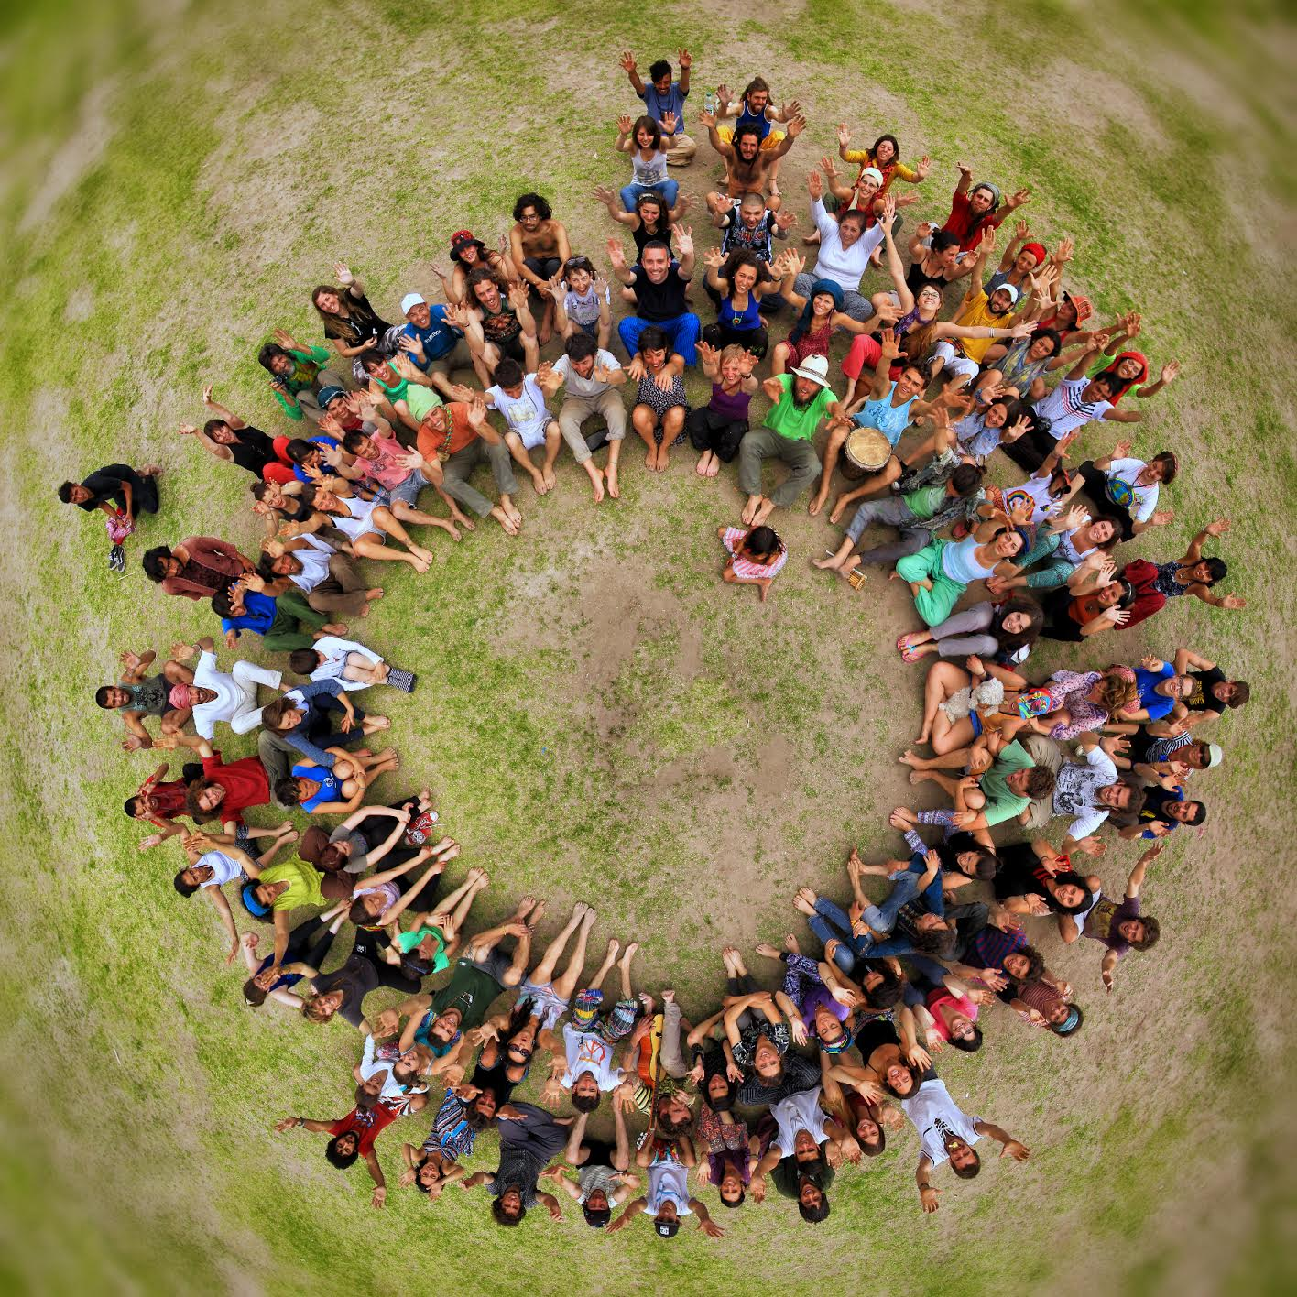
Church’s role in discipleship
The Church is the Body of Christ and making disciples is Christ’s ministry first of all
The Church supports you in it
By training you (in knowledge, experience, etc.)
By praying for you
By empowering you (through the Sacraments, etc.)

Slide 38
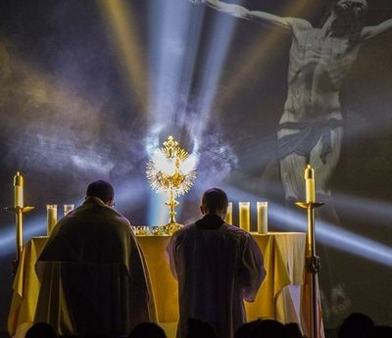
COME TO EUCHARISTIC ADORATION OFTEN!

Slide 39
seeking to know and live God’s will
sharing the faith with
one’s family
sharing
the really Good News
passionate prayer
desire to worship
taking risks for the Kingdom of God
attend to issues of justice
love for
the Church
joyful
service
some fruits of intentional discipleship
hunger to learn more about their faith
generous giving
loving care for the poor
vocational discernment
Weddell, Forming Intentional Disciples, 80-81
Notes:
Not required reading
When I pause to think about this list and assess if it’s true based on my experience, the first thing that comes to mind are the intentional disciples I met here in the M.Div. program. And anecdotally, it seems to be true. I haven’t encountered anyone in the M.Div. program who is all for some of these fruits but not others…so I think discipleship produces a fullness of fruits.
It’s not that problems go away. But I’m sure each of you can think of a small group, a ministry, or just a group of friends where almost everyone was an intentional disciple—and did these fruits manifest themselves?

Slide 40
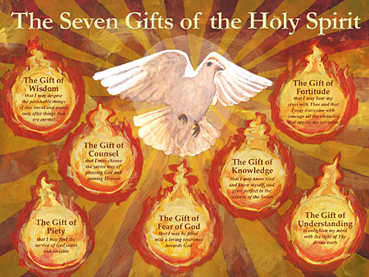
First step towards discipleship is to know the Gifts of the Holy Spirit, because the Spirit’s gifts are essential for learning and passing on our faith. P.91
See Fr. Gabor’s other presentation on the gifts of the Holy Spirit (https://www.stpetersaberdeen.com/faith-journey-for-grown-ups.htmlor https://www.sacredhearttorry.com/talks-by-fr-gabor.html)!

Slide 41
4
key
point
seek stories, not labels
Notes:
Labels don’t work.

Slide 42
?
liberal
laity
baptized
practicing Catholic
progressive
evangelical
left
active
atheist
pro-life
confirmed
clergy
right
convert
married in the Church
conservative
fallen away Catholic
Notes:
What is FID? Pause: What other labels might you add?

Slide 43
Basic STORY of Jesus’ life (Kerygma): life, suffering, death, resurrection of Jesus Christ Pass it on, by witnessing these in your own life and by words, because it is needed to awaken Faith!
This Photo by Unknown Author is licensed under CC BY

Slide 44
5
key
point
offering a framework for
Forming intentional Disciples
Notes:
No book is going to answer every challenge we face. In her “solution” portion, Weddell offers up a detailed framework for addressing Spiritual Journey #1.

Slide 45
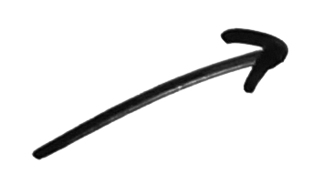
a framework for
any Christian spiritual journey
intentional discipleship
seeking
openness
curiosity
5
the
thresholds
of conversion
trust
Notes:
Not rigid, sometimes a different order, repeat phases, etc. But it’s a framework. I really remember my seeking threshold twice…

Slide 46
1. Trust (Initial trust, like feeling, BUT not an active personal faith): ‘ a person has a positive association with Jesus, the Church, a Christian believer or something identifiably Christian (a building, statue, idea, lifestyle, rule, etc. = this is what we call a BRIDGE OF TRUST). BUT trust is not the same as active personal faith.’ [In practice: Chatting with people to find common grounds and form a trusting relationship hugely helps, and also finding common interest that connect with the Church, Jesus, etc.]
2. Curiosity (spiritual curiosity): being intrigued by or desiring to know more about Jesus, his life, his teaching, or some aspect of the Christian faith. A person at this stage is not open to personal change. Curiosity is essentially passive. [Charisms of EVANGELISM, ENCOURAGEMENT can powerfully move others to open their lives to Christ, p. 93]
3. Openness (spiritual): openness to the possibility of personal and spiritual change. This is one of the most difficult transitions for a postmodern non-believer. Openness is not a commitment to change, it is simply openness to the possibility of change. [Charisms of TEACHING, WISDOM, can help remove obstacles to freely choosing personal faith and discipleship. P. 93] Pages 129-130

Slide 47
4. Spiritual seeking: At this stage the person is moving from essentially passive to actively seeking to know God who is calling him/her. ‘It is if you will, ‘’dating with a purpose’’, but not yet marriage.’ Seekers are asking: ‘are you the one to whom I will give myself.’ At this stage seekers engage in an urgent spiritual quest, seeking to know whether he or she can commit to Christ in his Church.’ [Charisms of HEALING, INTERCESSORY PRAYER, HOSPITALITY can enable the recipient to cooperate in Christ’s redemptive work, pp 93-94]
5. Intentional discipleship: this is the decision to ‘’drop the net’’, to make a conscious commitment to follow Jesus in the midst of his Church as an obedient disciple and to reorder one’s life accordingly.’ [Charisms of LEADERSHIP, ADMINISTRATION, MERCY and GIVING enable the recipient to cooperate in Christ’s redemptive work by healing society, p. 94] pages 129-130

